Slide 1
TravelWise
Rethink Your Trip
Angelo Papastamos
TravelWise Program Engineer

Slide 2
Strategies
UDOT’s TravelWise Program
A set of strategies that encourages Utahns to use alternatives to driving alone.
Alternative Schedules
Trip Chaining
Tele-
commuting
Skip the Trip
Public
Transit
Active Transportation
Carpooling/
Vanpooling

Slide 3
Benefits
Healthier communities and environment (air quality)
Improved physical and mental health
Decreased congestion
Enriched quality of life

Slide 4
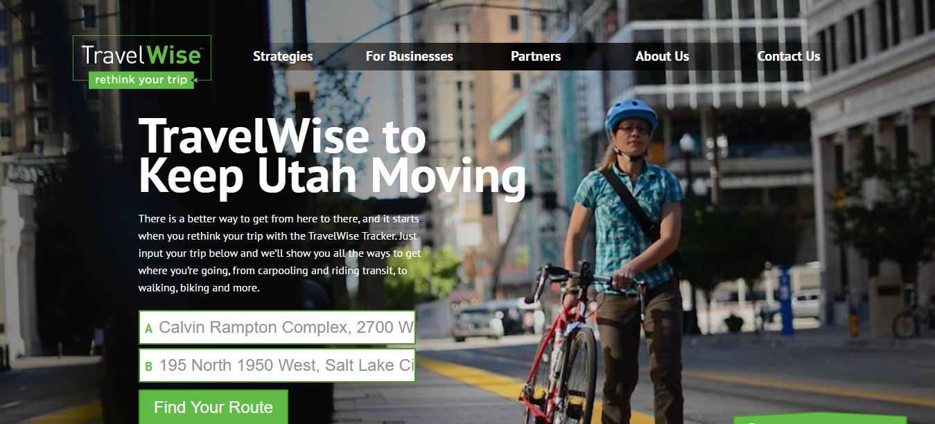
The Tracker

Slide 5
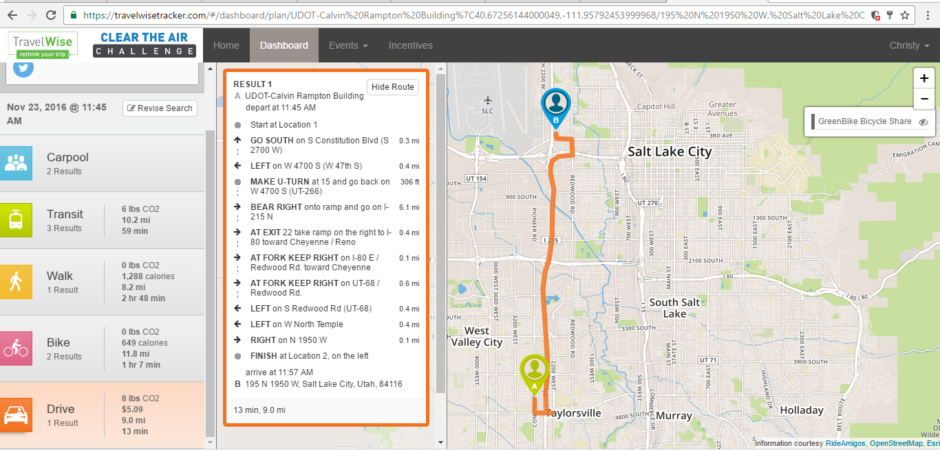
The Tracker
Strategy
Emissions
Distance
Time
Route

Slide 6
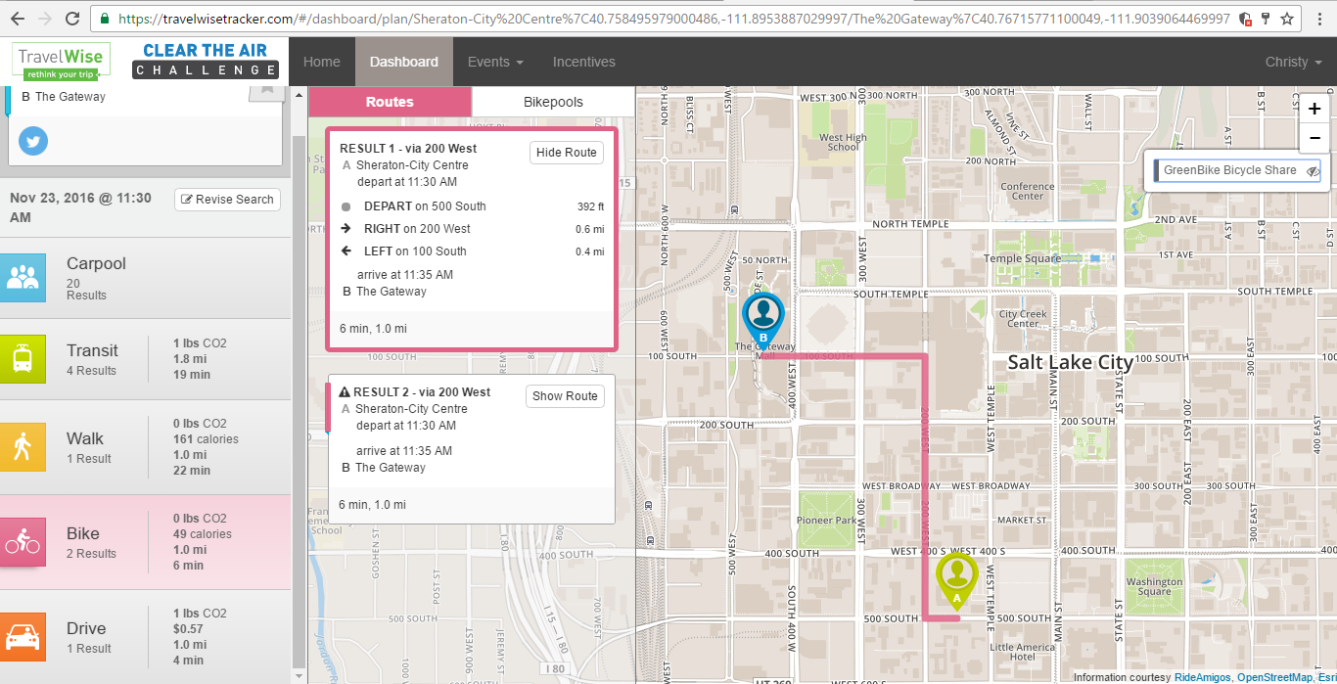
Interactive Map

Slide 7
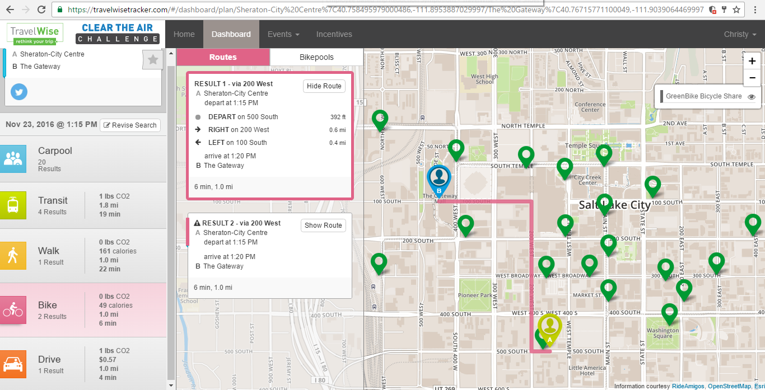
Interactive Map

Slide 8
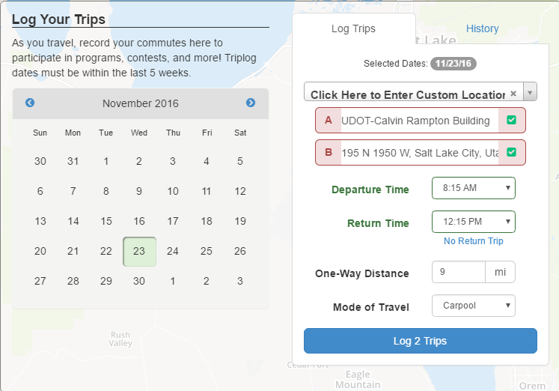
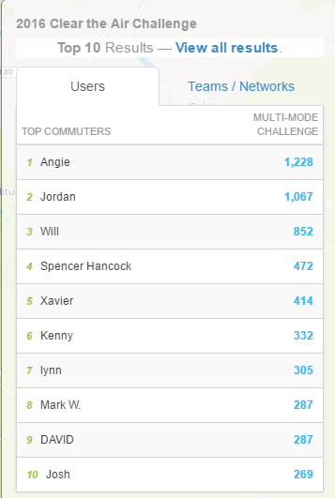
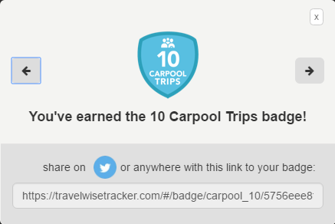
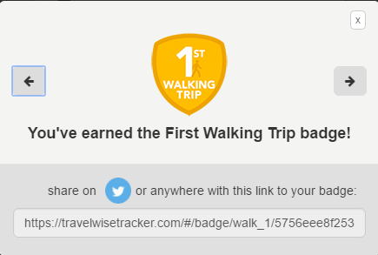
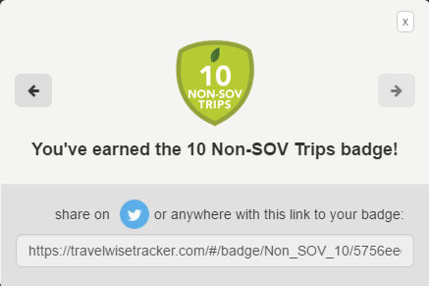
Your Dashboard

Slide 9
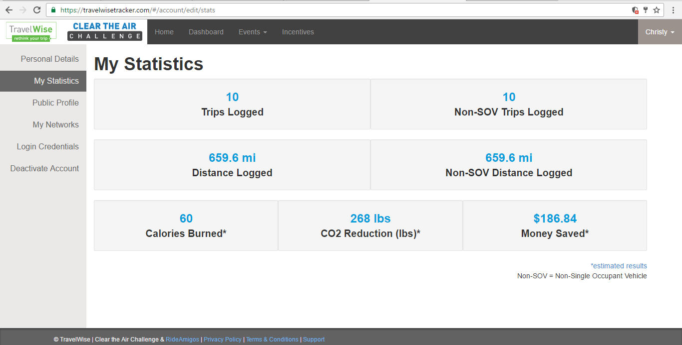
Your Statistics

Slide 10
Conclusion
User friendly tracker and dashboard
Reduce single occupant vehicles
Use alternate transportation strategies
Improve air quality
Improve health
TravelWise, it’s a verb

Slide 11
Partnerships

Slide 12
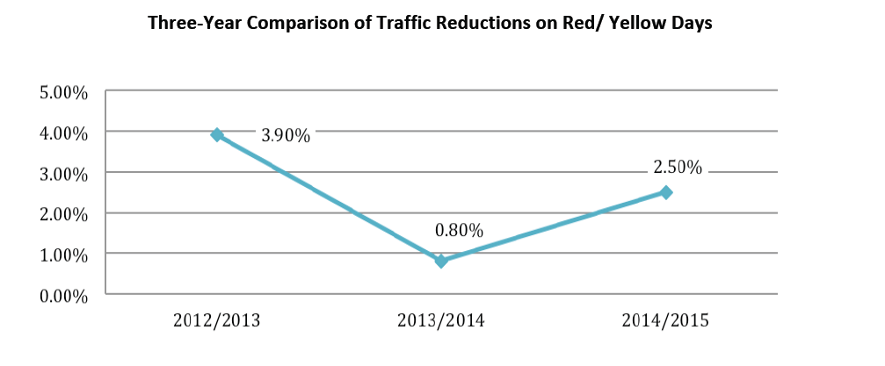
Past Trends

